Slide 1
CAMPUS PLACEMENT PERDICTION
BY:
NISHA A

Slide 2
AGENDA
Problem Statement
FLOW OF THE PROJECT
Data collection
Preprocessing
First Data-Frame
Class Imbalance
Outliers
Second Data-Frame
Feature Selection
Third Data-Frame
DEMERITS

Slide 3
PROBLEM STATEMENT
To develop a machine learning model that can accurately predict whether a student will be placed or not placed during campus placements.
Predictor is categorical column so Predicted the best fitted model using classification machine learning algorithm.

Slide 4
FLOW OF THE PROJECT
Data Collection
Data Preprocessing
Data Frame 1
Class Imbalance
EDA
Feature selection
Data Frame 2
Data Frame 3

Slide 5
DATA COLLECTION
In Dataset there are 10000 rows and 12 columns.
It has 9 columns consist of numerical values and 3 are categorical.
Target columns is categorical so, I perform Classification Machine learning Algorithm.

Slide 6
PREPROCESSING
Missing Value Treatment
Data Type Conversion
Duplicate Checking

Slide 7
DATAFRAME 1
S.NO | Model Name | Accuracy | fpr | tpr | f1Score
1 | Logistic Regression | 76.90 | 0.259901 | 0.788591 | 0.802733
2 | Decision Tree | 72.15 | 0.329208 | 0.753356 | 0.762309
3 | Random Forest | 78.70 | 0.275184 | 0.841618 | 0.819753
4 | Navie Bayes | 75.05 | 0.299505 | 0.835570 | 0.819753
5 | Support Vector Model | 77.70 | 0.356436 | 0.822987 | 0.819753
6 | KNN | 78.10 | 0.295792 | 0.826342 | 0.797237
7 | AdaBoost | 72.90 | 0.301980 | 0.758389 | 0.815397
8 | XGBoost | 78.20 | 0.284653 | 0.827181 | 0.818937

Slide 8
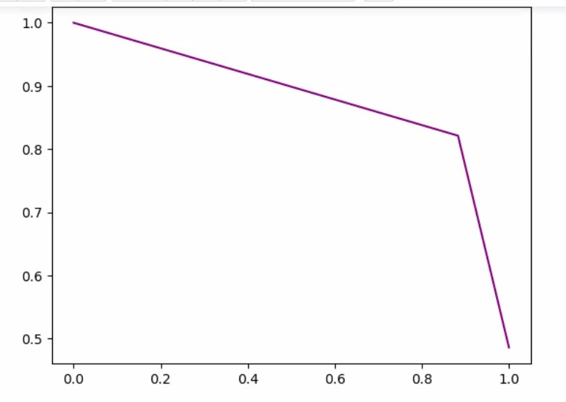
CONCULSION FOR DATAFRAME 1:
Random Forest (rf) model achieved the highest accuracy at 79.70 and also had a relatively low false positive rate (fpr) of 0.275184 and tpr 0.841618
Result of PRC curve

Slide 9
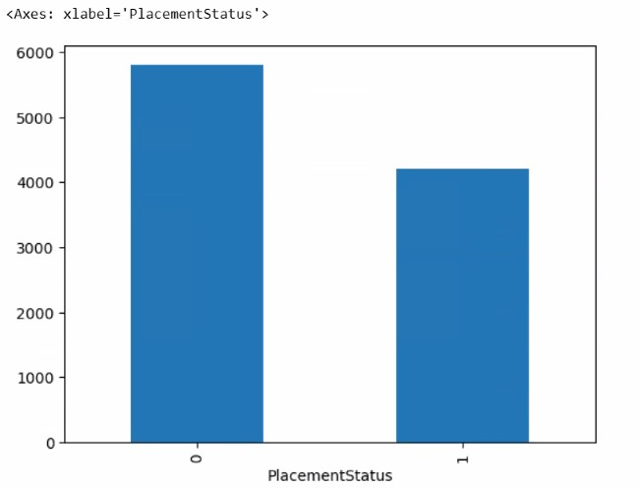
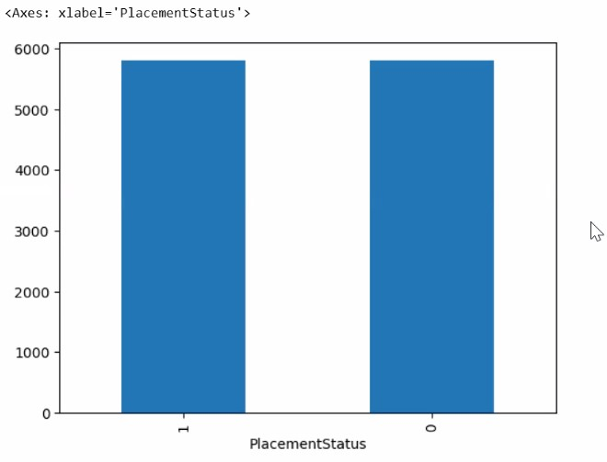
CLASS IMBALANCE
I perform oversampling technique these are before and after the class imbalance.
Before
After

Slide 10
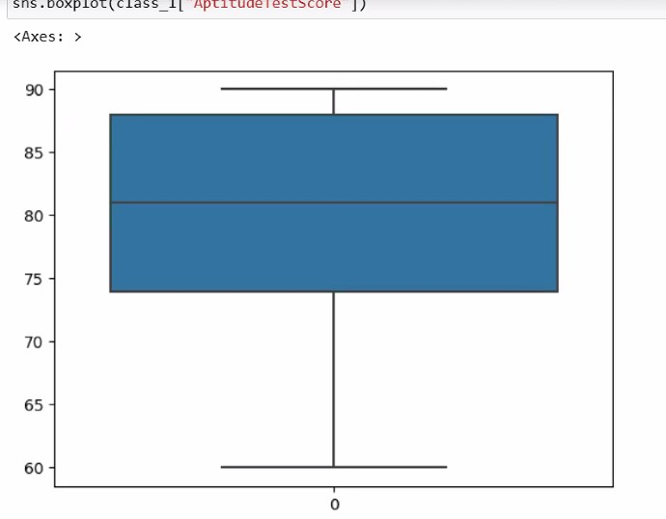
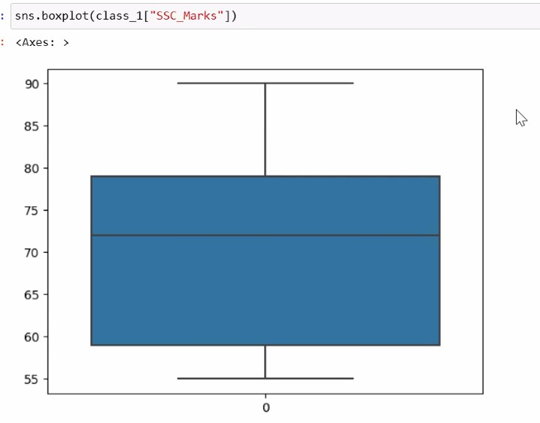
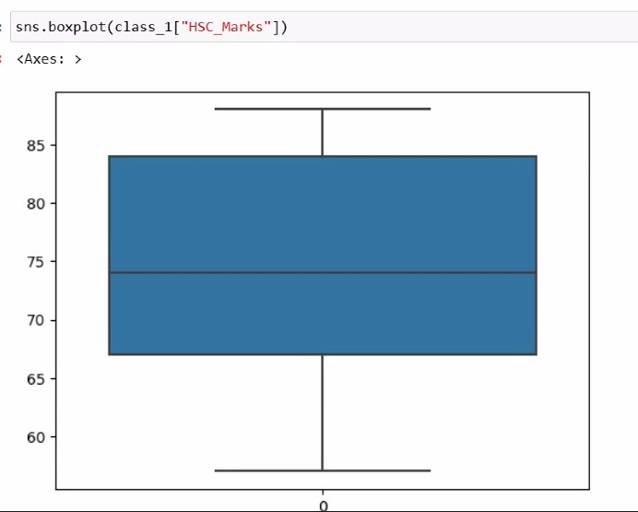
OUTLIER TREATMENT
Data Not Having Outlier and Skewness
Aptitude Score
SSC Marks
HSC Marks

Slide 11
DATAFRAME 2
S.NO | Model Name | Accuracy | fpr | tpr | f1Score
1 | Logistic Regression | 77.950043 | 0.164894 | 0.733668 | 0.776596
2 | Decision Tree | 81.309216 | 0.097518 | 0.764657 | 0.823636
3 | Random Forest | 87.080103 | 0.082447 | 0.826633 | 0.936071
4 | Navie Bayes | 75.050000 | 0.309406 | 0.840604 | 0.819967
5 | Support Vector Model | 77.700000 | 0.356436 | 0.822987 | 0.797237
6 | KNN | 78.000000 | 0.295792 | 0.826342 | 0.815397
7 | AdaBoost | 79.200000 | 0.283416 | 0.838926 | 0.826105
8 | XGBoost | 78.200000 | 0.284653 | 0.827181 | 0.818937
Conclusion: Random Forest (rf) model achieved the highest accuracy at 87.080103 and also had a relatively low false positive rate (fpr) of 0.082447 and tpr 0.826633

Slide 12
FEATURE ENGINEERING
For Feature selection go with RFE(Recursive Feature Elimination )
Dataset having 10 column in that only 5 column selected as a importance feature which are significant.

Slide 13
DATAFRAME 3
S.NO | Model Name | Accuracy | fpr | tpr | f1Score
1 | Logistic Regression | 78.552972 | 0.283416 | 0.838926 | 0.826105
2 | Decision Tree | 82.515073 | 0.284653 | 0.827181 | 0.818937
3 | Random Forest | 86.046512 | 0.187943 | 0.768007 | 0.789496
4 | Navie Bayes | 62.747631 | 0.105496 | 0.747069 | 0.809070
5 | Support Vector Model | 78.122308 | 0.086879 | 0.817420 | 0.860670
6 | KNN | 77.519380 | 0.330674 | 0.588777 | 0.619383
7 | AdaBoost | 82.644272 | 0.231383 | 0.804020 | 0.795031
8 | XGBoost | 82.342808 | 0.290842 | 0.747069 | 0.619383
Conclusion: Random Forest (rf) model achieved the highest accuracy at 86.046512 and also had a relatively low false positive rate (fpr) of 0.187943 and tpr 0.768007

Slide 14
DEMERITS
Demerits:
Limited scope in capturing the holistic skills and talents of students beyond academic performance.
Potential bias in data collection and reporting, leading to inaccurate representations.
Overemphasis on placement statistics may overshadow the importance of overall student development.
Doesn't account for students pursuing entrepreneurship or further studies instead of immediate employment.

Slide 15
THANK YOU

